Slide 1
Operating System Introduction

Slide 2
WHAT IS AN OPERATING SYSTEM?
An interface between users and hardware
Allows convenient and efficient usage
Provides information protection
Gives each user a slice of the resources
Acts as a control program

Slide 3
WHAT IS AN OPERATING SYSTEM?
A program that runs on the raw hardware and supports
Resource Abstraction
Resource Sharing
Abstracts and standardizes the interface to the user across different types of hardware
Virtual machine hides the messy details which must be performed
Manages the hardware resources
Each program gets time with the resource
Each program gets space on the resource
May have potentially conflicting goals
Use hardware efficiently
Give maximum performance to each user

Slide 4
WHAT IS AN OPERATING SYSTEM?
Separates applications from the hardware they access
Software layer
Manages software and hardware to produce desired results
Operating systems primarily are resource managers
Hardware
Processors
Memory
Input/output devices
Communication devices
Software applications

Slide 5
Goals
Users expect certain properties of operating systems
Efficiency
Robustness
Scalability
Extensibility
Portability
Security
Protection
Interactivity
Usability

Slide 6
Types of Operating System
Embedded systems
Characterized by small set of specialized resources
Provide functionality to devices such as cell phones and PDAs
Efficient resource management key to building successful operating system
Real-time systems
Require that tasks be performed within particular (often short) time frame
Autopilot feature of an aircraft must constantly adjust speed, altitude and direction
Such actions cannot wait indefinitely—and sometimes cannot wait at all

Slide 7
Types of Operating System
Distributed systems
A collection of independent computers that appears to its users as a single coherent system
Distributed vs. Single systems
Data sharing
Device/ resource sharing
Communication
Flexibility
Extensibility

Slide 8
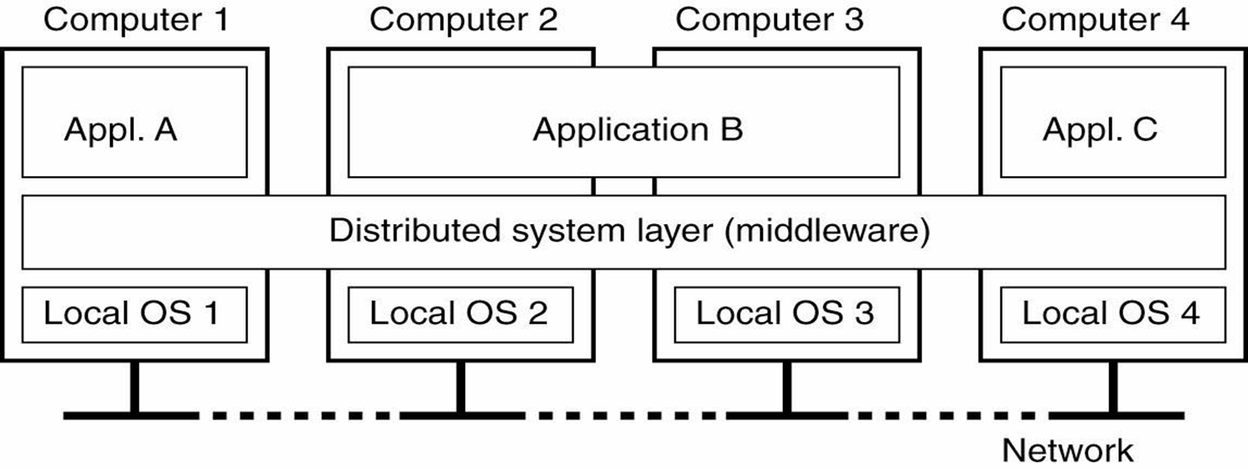
Distributed Systems
A distributed system organized as middleware. The middleware layer extends over multiple machines, and offer each application the same interface

Slide 9
Types of Operating System
Cluster computing
Computer clusters using commodity processors, network interconnects, and operating systems
Super-compting
Highly-tuned computer clusters using commodity processors combined with customized network interconnects and customized operating system
Grid computing
It tends to be composed of multiple clusters, and are typically loosely coupled, heterogeneous, and geographically dispersed

Slide 10
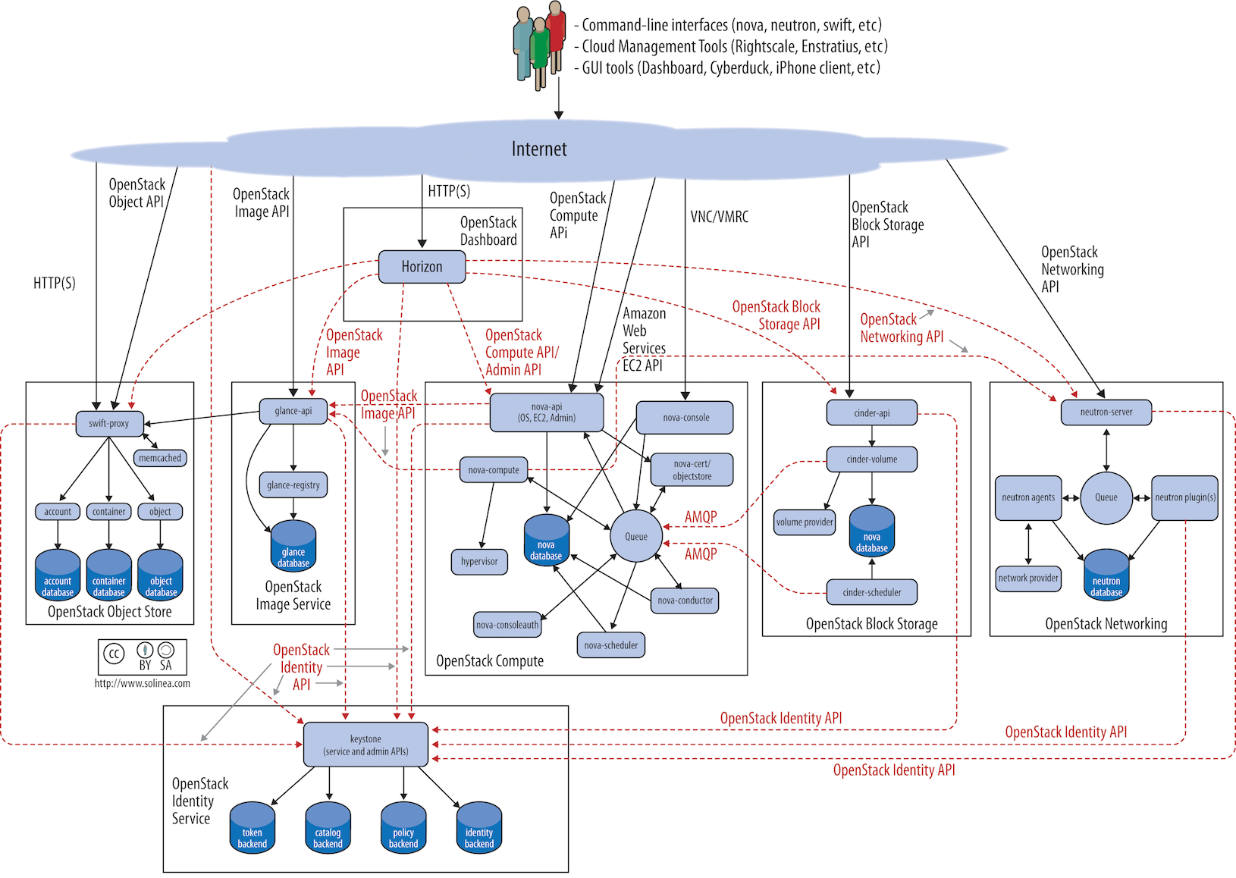
Types of Operating System
Cloud computing
A large-scale distributed computing paradigm driven by
Economies of scale
Virtualization
Dynamically-scalable resources delivered on demand over the Internet
OpenStack

Slide 11
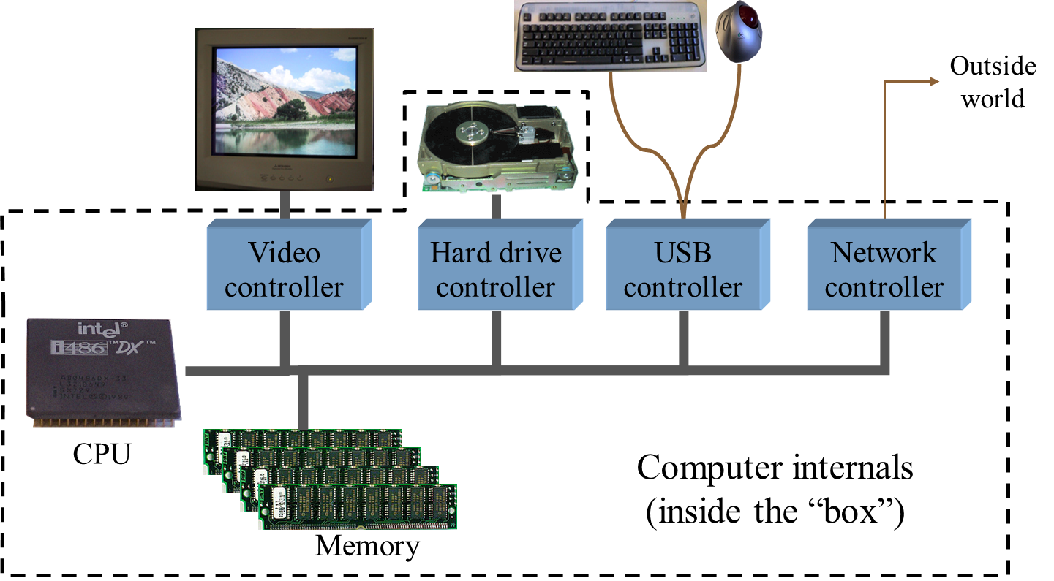
Components of a Simple PC

Slide 12
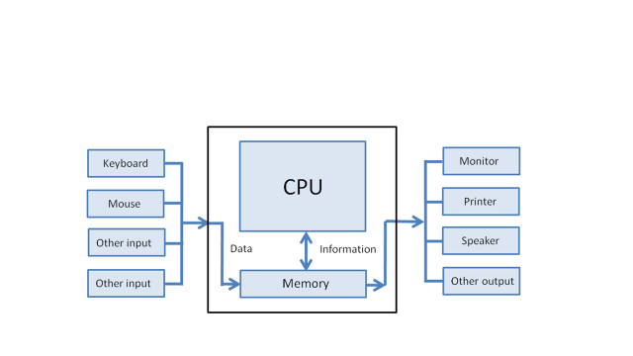
Components of a Simple PC

Slide 13
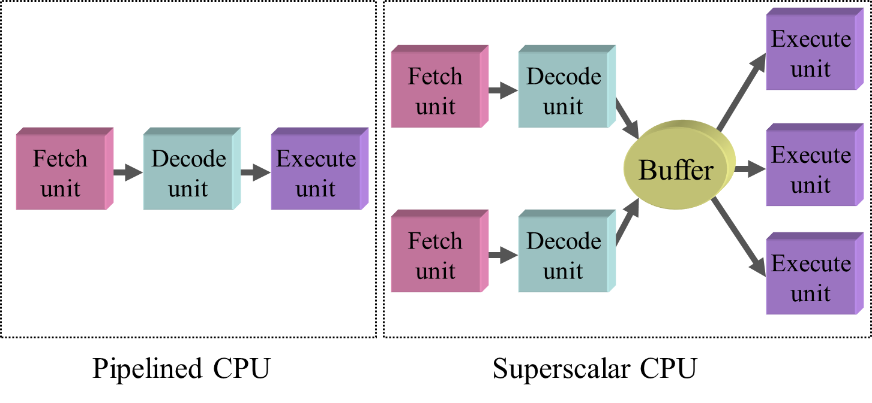
CPU Internals

Slide 14
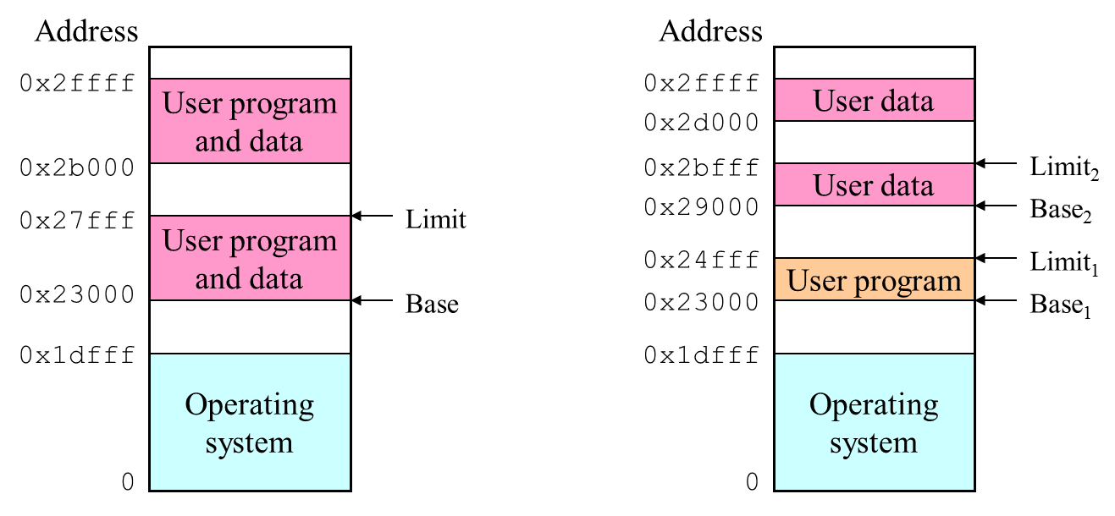
Memory
A user program can only access its own logical memory
Single base/limit pair: set for each process
Two base/limit registers: one for program, one for data

Slide 15
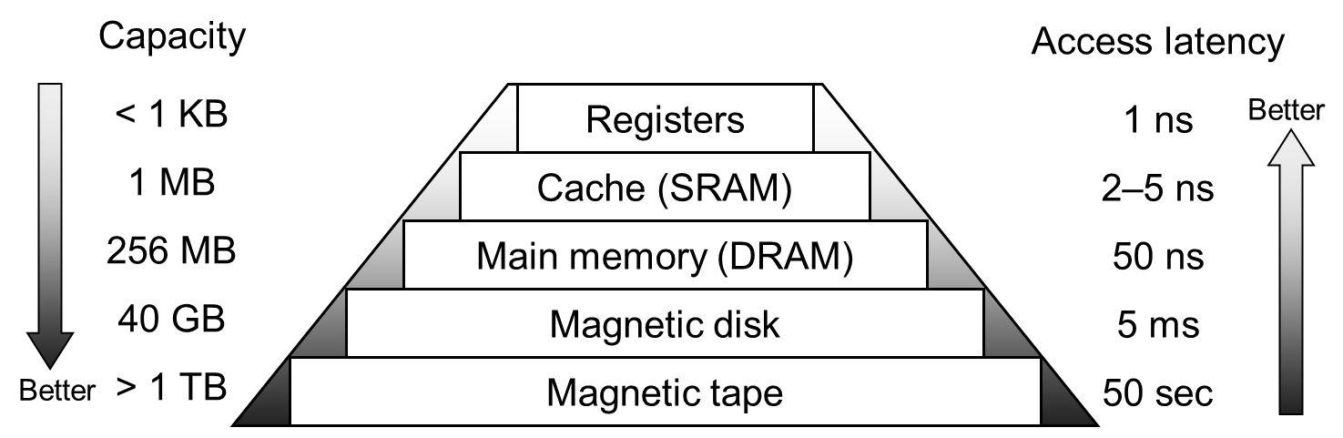
Storage Pyramid
Goal: really large memory with very low latency
Latencies are smaller at the top of the hierarchy
Capacities are larger at the bottom of the hierarchy
Solution: move data between levels to create illusion of large memory with low latency

Slide 16
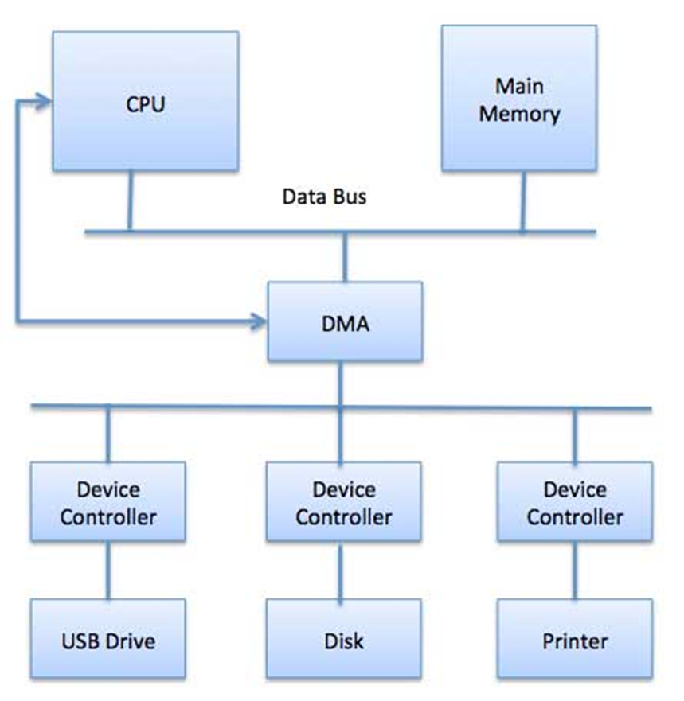
Device Access

Slide 17
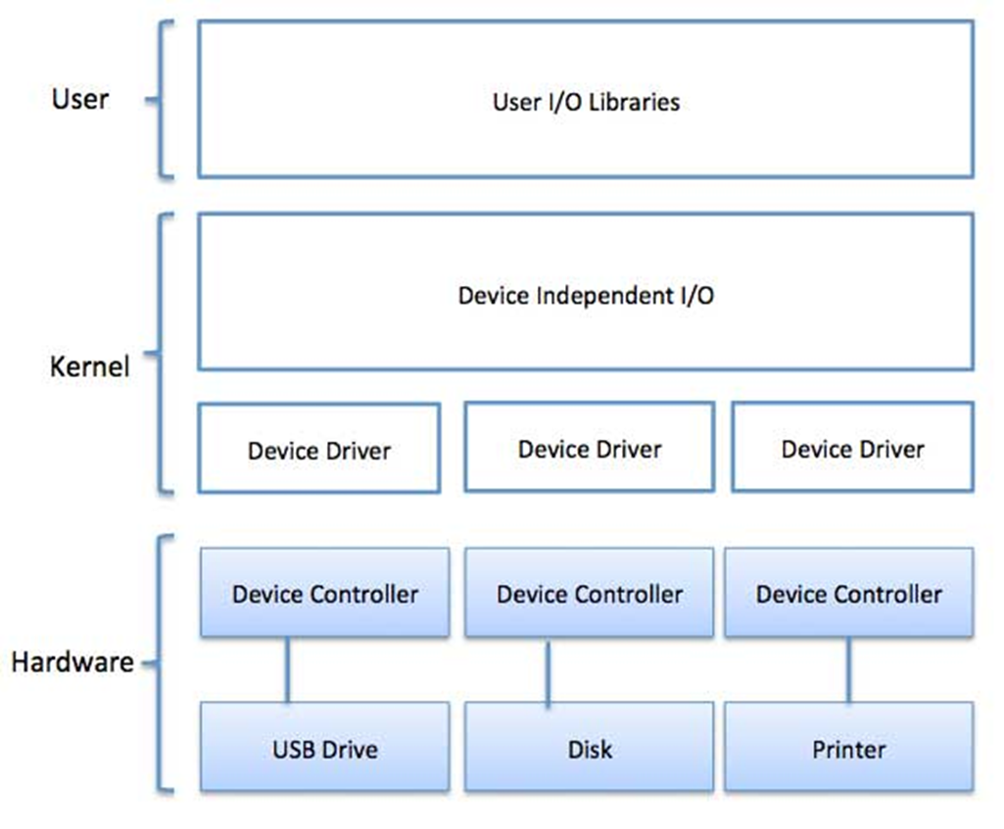
Device Access Path

Slide 18
Core Operating System Components
User interaction with operating system
Often, through special application called a shell
Kernel
Software that contains core components of operating system
Typical operating system components include:
Processor scheduler
Memory manager
I/O manager
Inter-process communication (IPC) manager
File system manager

Slide 19
Multiprogramming
While one job waits for a resource, the CPU can find another job to run
It means that several jobs are ready to run and only need the CPU in order to continue
Kernel manages the execution of processes
Program components which execute independently but use single memory space to share data are called threads.
To access I/O device, process must issue system call
Handled by device driver
Software component that interacts directly with hardware
Often contains device-specific commands

Slide 20
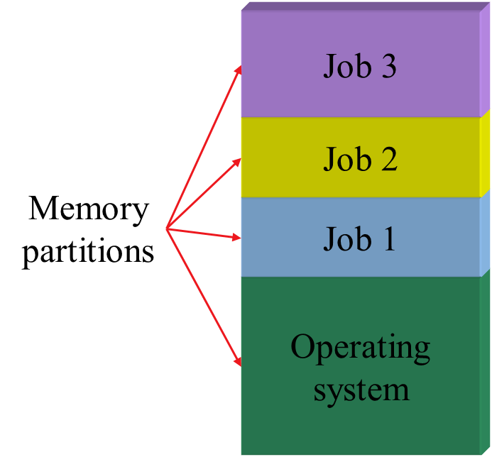
Multiprogramming
Multiple jobs in memory
Protected from one another
Operating system protected from each job as well
Resources (time, hardware) split between jobs

Slide 21
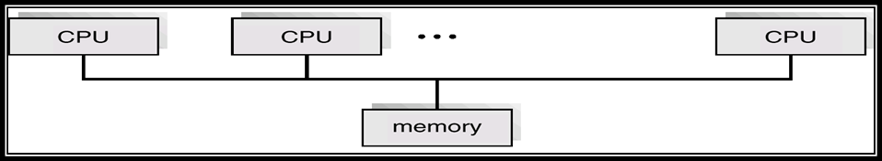
Multiprocessing
Tightly coupled systems that communicate via shared memory. Used for scientific applications. Used for speed improvement by putting together a number of off-the-shelf processors

Slide 22
Time Sharing
Multiprogramming allowed several jobs to be active at one time
Initially used for batch systems

Slide 23
System Calls
It is used by an application program to request service from the operating system.
System calls often use a special machine code instruction which causes the processor to change mode (e.g. to "supervisor mode" or "protected mode").
This allows the OS to perform restricted actions such as accessing hardware devices or the memory management unit.
Comprise a set of functions (often known as API) that can be used by the applications and library routines to use the services provided by the kernel

Slide 24
System Calls
Programs want the OS to perform a service
Access a file
Create a process
Accomplished by system call
Program passes relevant information to OS
OS performs the service if
The OS is able to do so
The service is permitted for this program at this time
OS checks information passed to make sure it’s OK
Don’t want programs reading data into other programs’ memory

Slide 25
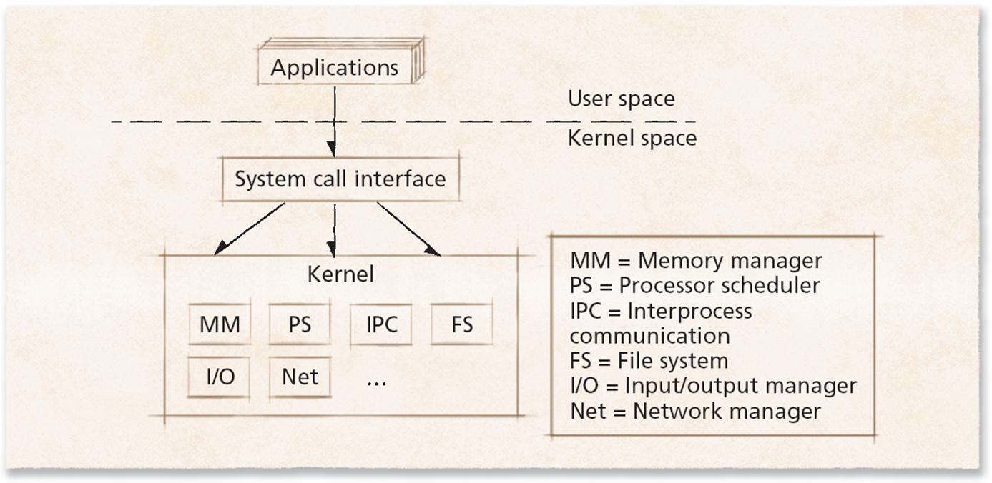
System Calls

Slide 26
System Calls
0xffffffff
Library (read call)
System call: read(fd, buffer, length)
Program pushes arguments, calls library (1, 2)
Library sets up trap, calls OS (3, 4)
OS handles system call (5, 6)
Control returns to library (7)
Library returns to user program (8, 9)
Return to caller
Trap to kernel
3
Trap code in register
User space
2
8
4
Increment SP
9
7
Call read
1
Push arguments
User code
Kernel space (OS)
Dispatch
5
6
Sys call handler
0

Slide 27
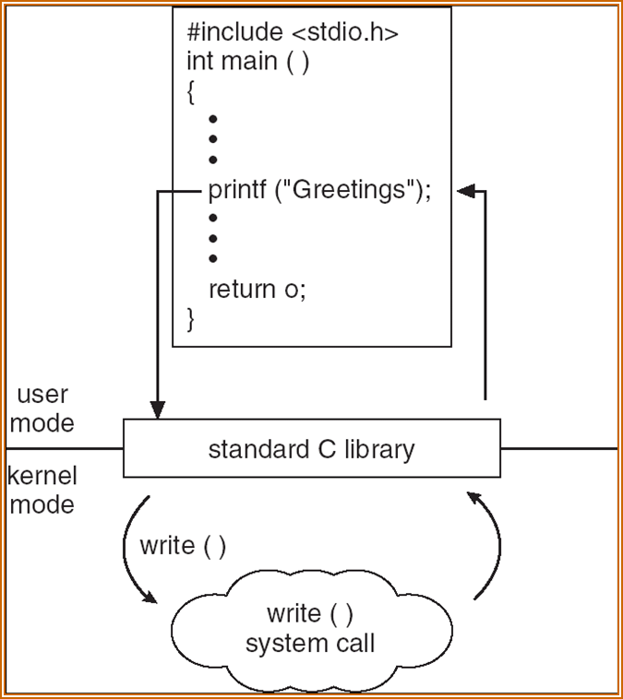
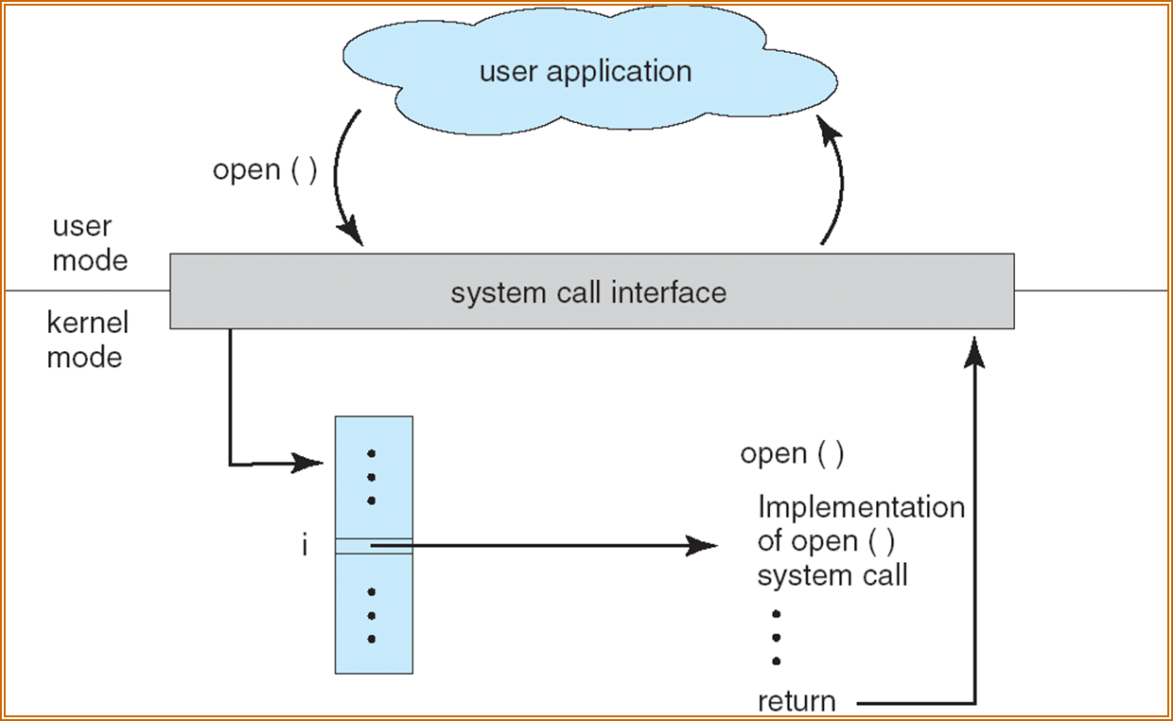
System Calls
C program invoking printf() library call, which calls write() system call

Slide 28
APIs vs. System Calls
An application programmer interface is a function definition that specifies how to obtain a given service
An API does not necessarily correspond to a specific system call
The API could offer its services directly in User Mode.
A single API function could make several system calls.
Several API functions could make the same system call, but wrap extra functionality around it.
A system call is an explicit request to the kernel made via a software interrupt
Usually, each system call has a corresponding wrapper routine, which defines the API that application programs should employ.

Slide 29
APIs vs. System Calls
Different APIs issue the same system call
In Linux, the malloc( ) , calloc( ) , and free( ) APIs are implemented in the libc library.
The code in this library keeps track of the allocation and deallocation requests and uses the brk( ) system call to enlarge or shrink the process heap.

Slide 30
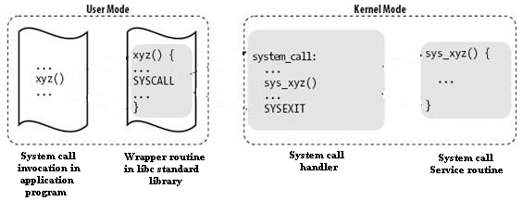
Control Flow Diagram of a System Call

Slide 31
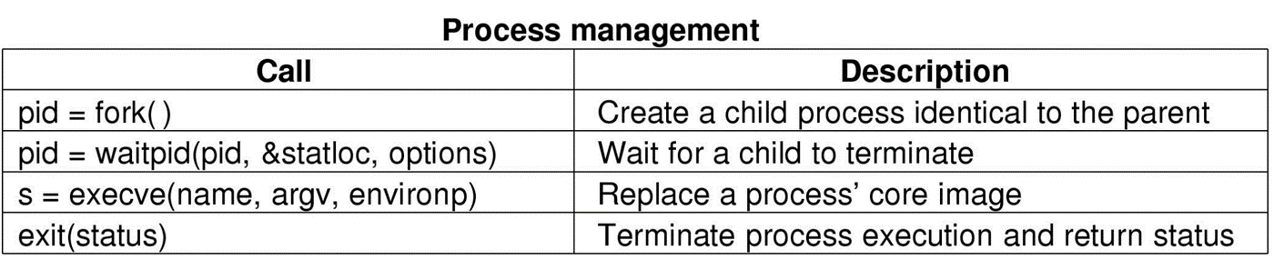
System Calls For Process Management

Slide 32
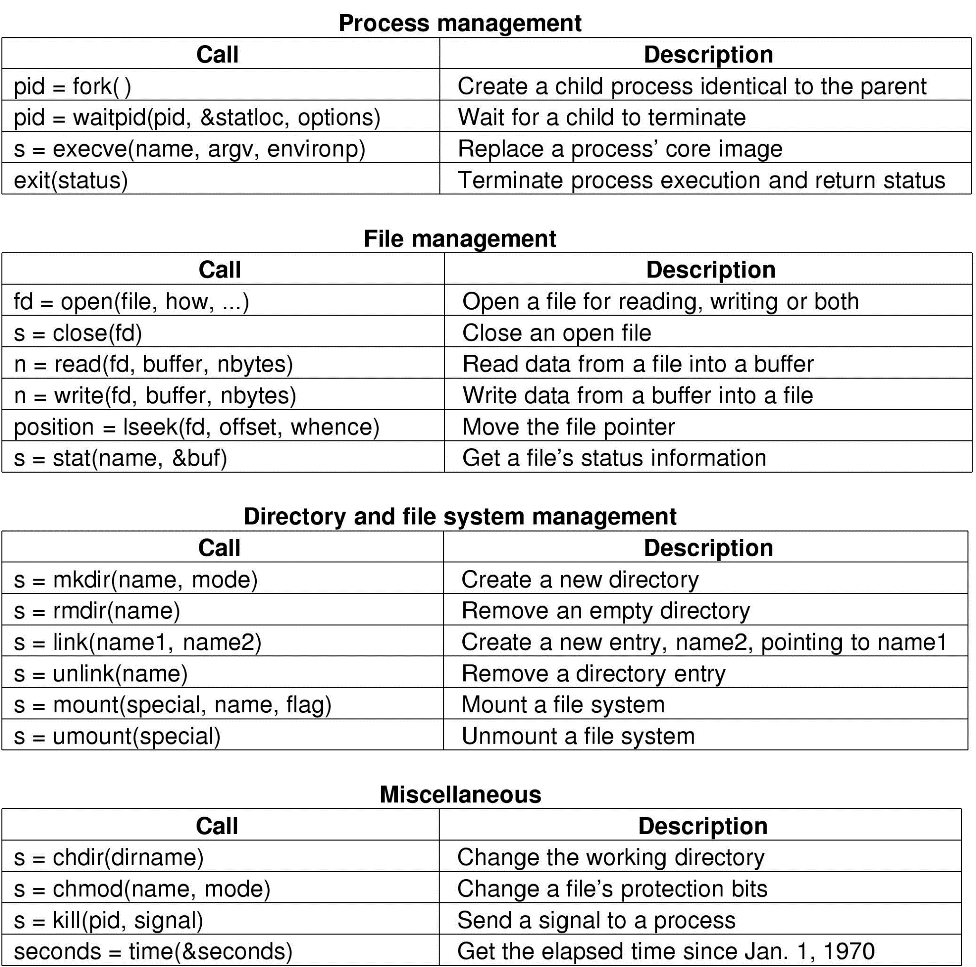
System Calls For File Management

Slide 33
System Calls For Directory Management

Slide 34
System Calls For Miscellaneous Tasks

Slide 35
System Calls
File Management
Control the creation, removal of files and provide directory maintenance
For a multiuser system, every user should have its own right to access files and directories
Process Management
For a multitask system, multiple programs can be executed simultaneously in the system
When a program starts to execute, it becomes a process
The same program executing at two different times will become two different processes
Kernel manages processes in terms of creating, suspending, and terminating them
A process is protected from other processes and can communicate with the others

Slide 36
System Calls
Memory management
Memory in a computer is divided into main memory and secondary storage
Memory is small in capacity but fast in speed, and hard disk is vice versa
Data that are not currently used should be saved to hard disk first, while data that are urgently needed should be retrieved and stored in RAM
The mechanism is referred as memory management
Device drivers
Interfaces between the kernel and the BIOS
Different device has different driver

Slide 37
Interrupts
Interrupt transfers control to the interrupt service routine generally, through the interrupt vector, which contains the addresses of all the service routines
Interrupt architecture must save the address of the interrupted instruction
Incoming interrupts are disabled while another interrupt is being processed to prevent a lost interrupt
A trap is a software-generated interrupt caused either by an error or a user request
An operating system is interrupt driven

Slide 38
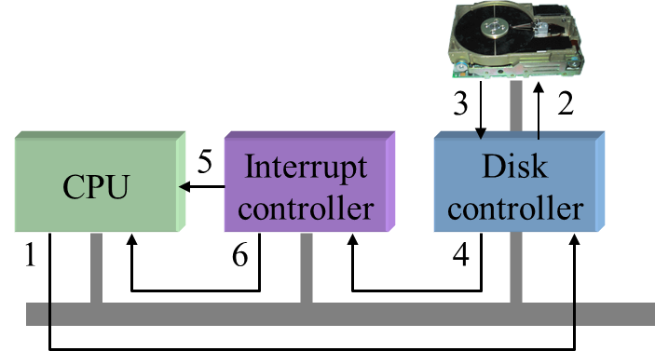
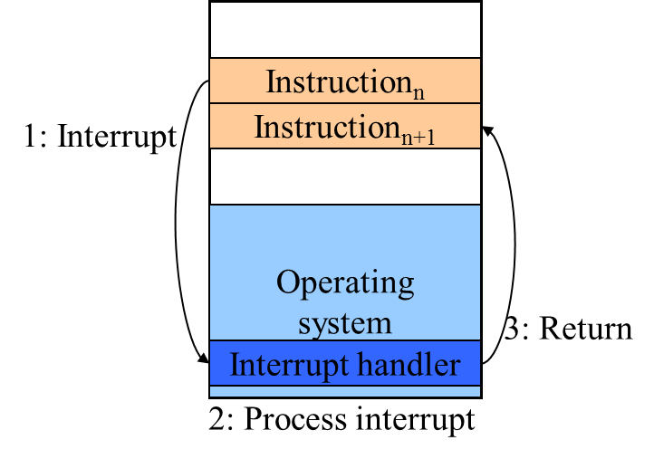
A Device Request
Sequence as seen by hardware
Request sent to controller, then to disk
Disk responds, signals disk controller which tells interrupt controller
Interrupt controller notifies CPU
Interrupt handling (software point of view)

Slide 39
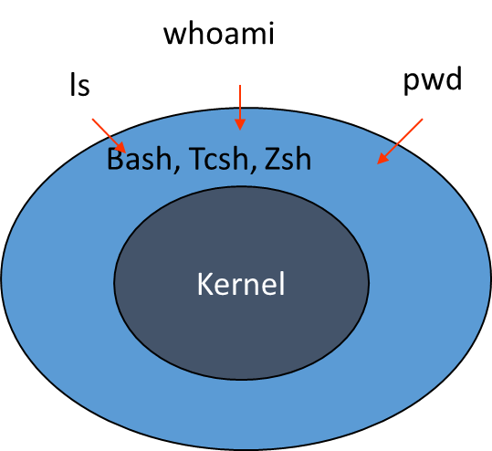
Linux Shell
Shell interprets the command and request service from kernel
Similar to DOS but DOS has only one set of interface while Linux can select different shell
Bourne Again shell (Bash), TC shell (Tcsh), Z shell (Zsh)

Slide 40
Protection and Security
OS must protect itself from users
reserved memory only accessible by OS
hardware enforced
OS may protect users from one another
not all systems do this
hardware enforced again

Slide 41
Protection and Security
Dual -Mode Operation
user mode
limited set of hardware instr and memory available
mode all user programs run in
supervisory mode
all hardware instr and memory are available
mode the OS runs in
Never let user run in supervisory mode

